Slide 1
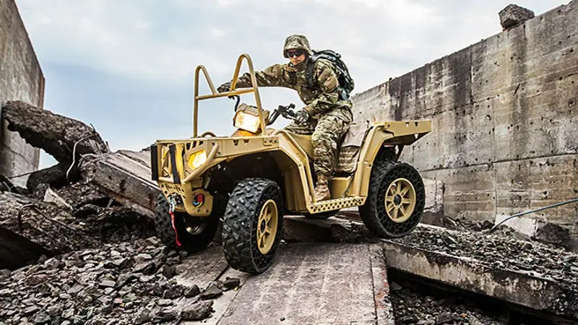
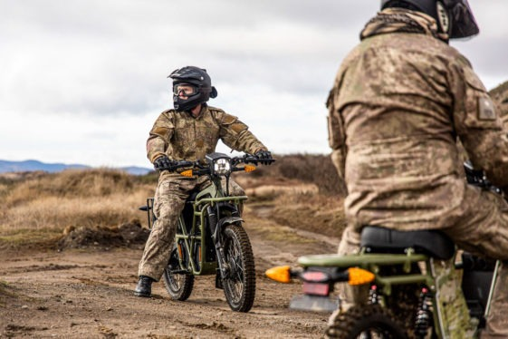
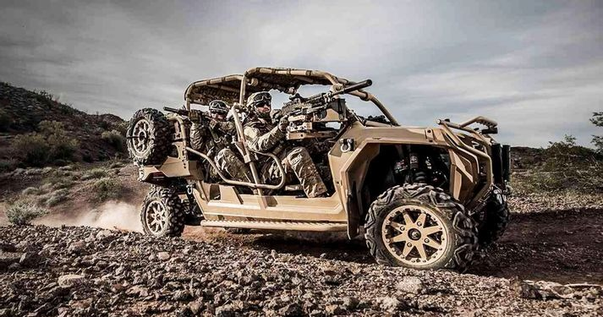
AFSOC Light-Tactical Vehicle Training

Slide 2
THIS PAGE IS INTENTIONALLY LEFT BLANK

Slide 3
Training Curriculum
TRAINING FOR EACH PLATFORM INCLUDES THE FOLLOWING
Vehicle Nomenclature
T-CLOC
Hand & Arm Signals
Personal Protective Equipment
Load Planning
Roll-Over Recovery
Recommended Range Set Up
Starting & Stopping
Turning (Figure 8)
Sharp Turns
Quick Stops & Swerves
Riding Over Obstacles
Quicker Turns
Traversing Hills
Night Vision Goggles
Open Trail Experience
Chief Instructors (CIs) are designated by unit Commanders in writing and are authorized to certify additional CIs within their unit. Further PPE requirements are outlined in AFI 91-207 AFSOC Supplement

Slide 4
ATV Nomenclature
Parking Brake
Hand Brake
Foot Brake
Throttle
Ignition Switch
Engine Stop Switch
Fuel Supply Valve
Choke
Clutch Lever
Shift Lever
Starter
Lights
Reverse Gear
Transmission Hi/Low
Tires
Fenders

Slide 5
Dirt Bike Nomenclature
Parking Brake
Hand Brake
Foot Brake
Throttle
Ignition Switch
Engine Stop Switch
Fuel Supply Valve
Choke
Clutch Lever
Shift Lever
Starter
Lights
Reverse
Tires
Fenders

Slide 6
MRZR Nomenclature
Parking Brake
Foot Brake
Throttle
Ignition Switch
Shift Lever
Starter
Lights
Reverse Gear
Transmission Hi/Low
Engine Stop Switch
Chassis
Tires
Rollover Protection System (ROPS)
Occupant Retention System (ORS)
Fenders
Deck/Floor

Slide 7
THIS PAGE IS INTENTIONALLY LEFT BLANK

Slide 8

T-CLOC Inspection
T – Tires & Wheels
    Air Pressure
    Condition
    Wheel Bearings, Lug Nuts, Etc.
C – Controls & Cables
    Location
    Operation
    Throttle
    Brakes
    Shifter
    Clutch
L – Lights & Electrics
    Ignition Switch
    Engine Stop Switch
    Lights
O – Oil & Fuel
    Levels
    Vents
    Air Filter
    Fuel Supply Valve
C- Chain/Driveshaft & Chassis/Suspension
    Condition
    Lubrication
    Wear

Slide 9
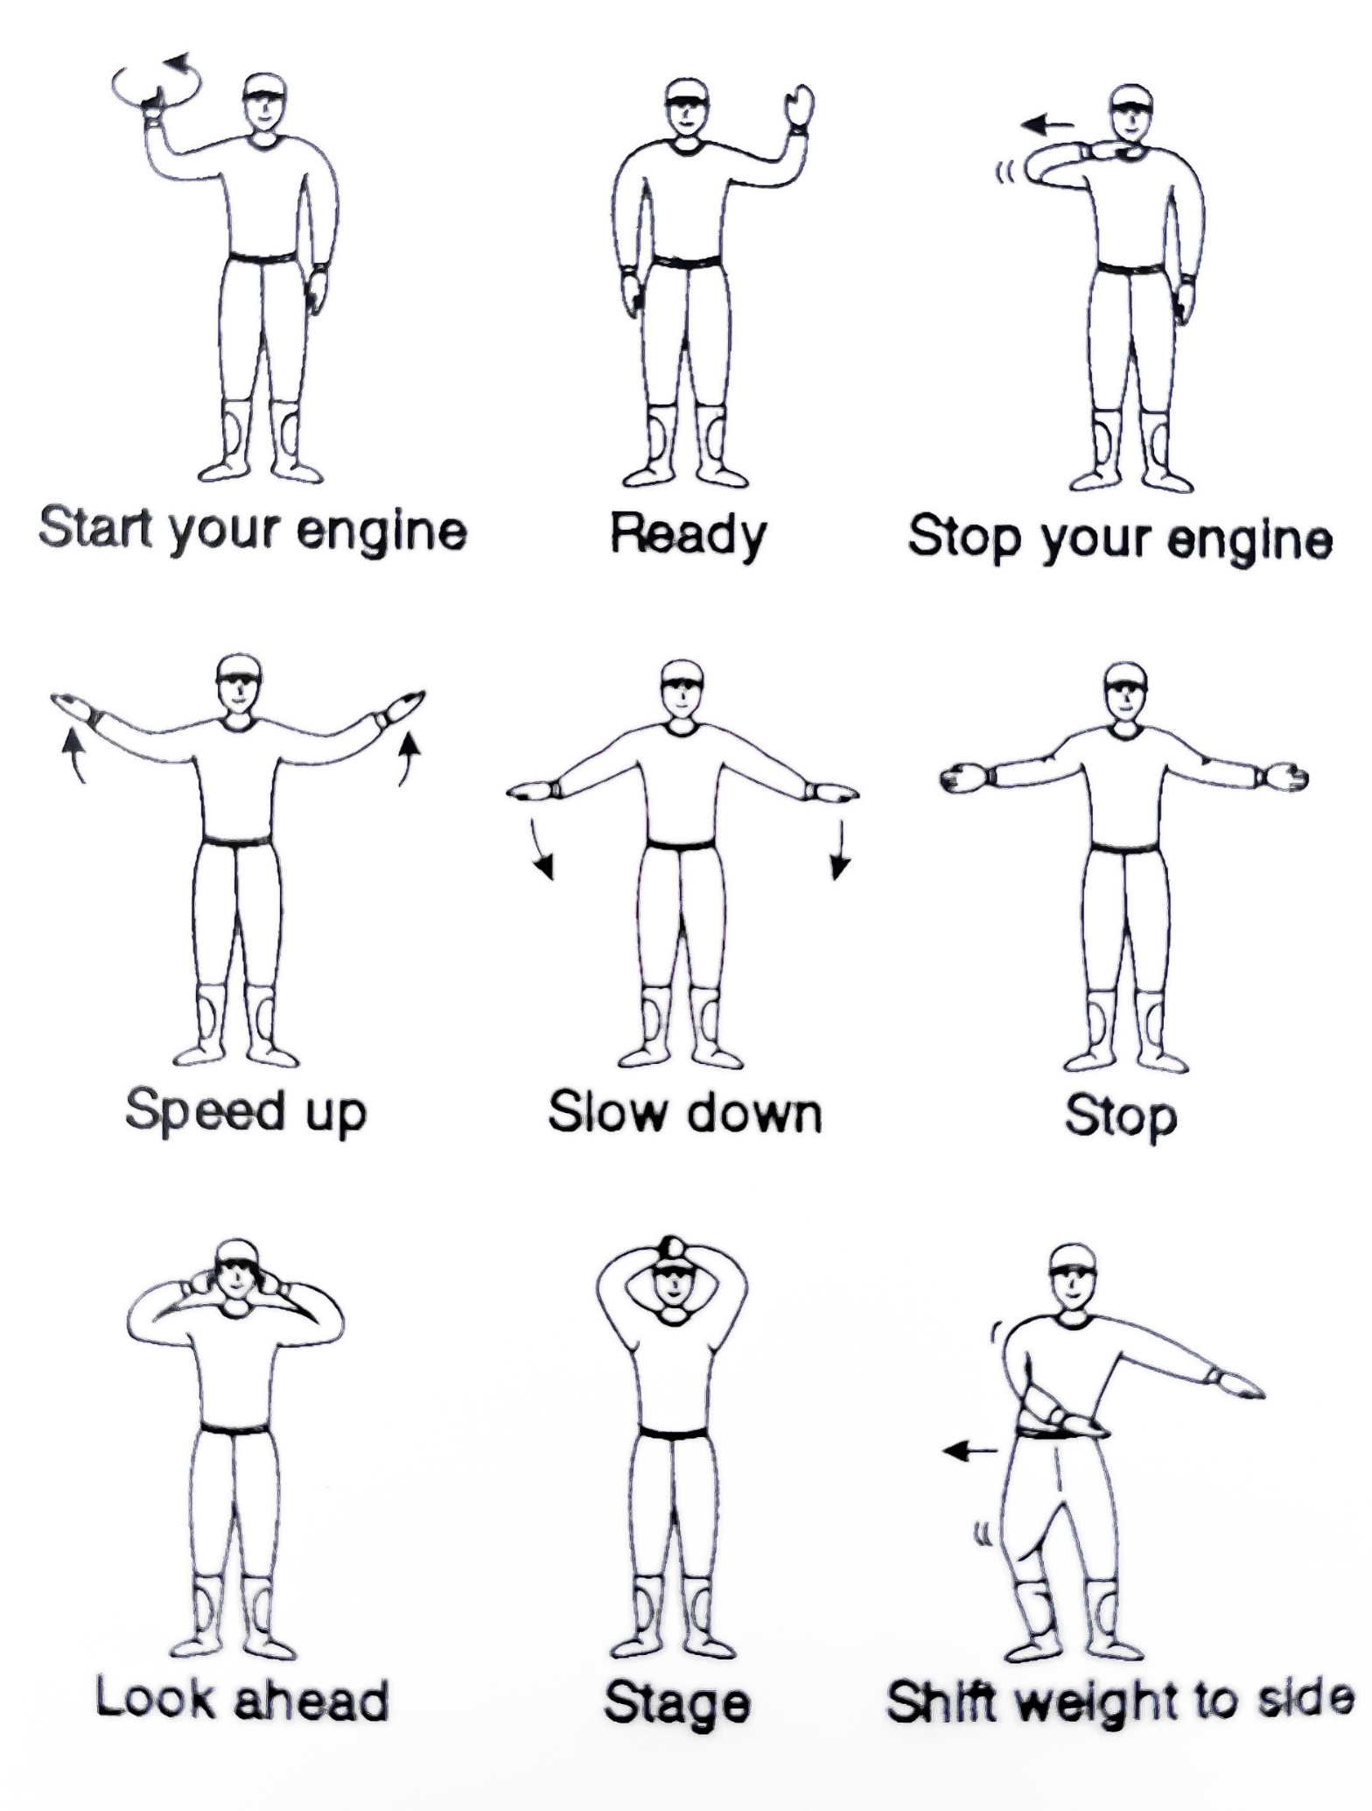
Hand/Arm Signals
Start Your Engine
Ready
Stop Your Engine
Speed Up
Slow Down
Stop
Look Ahead
Stage
Shift Weight

Slide 10
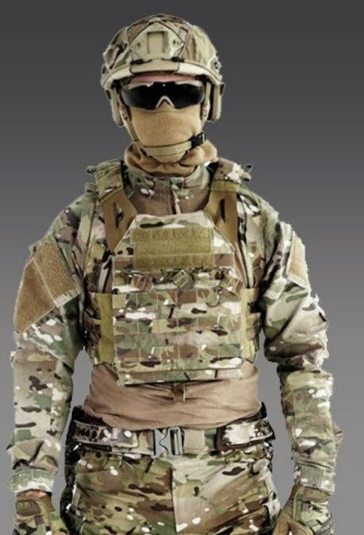
Personal Protective Equipment (PPE)
Helmet
Eye Protection
Long Sleeves
Gloves
Pants
Over the Ankle Footwear

Slide 11
Load Planning
Identify manufacturer recommended load capacity.
Identify vehicle load limitations.
Identify the center of gravity for the vehicle.
Identify angle of approach, departure, and ramp.
Identify cargo tie-down points.

Slide 12
Rollover Recovery
Manual Recovery
  Personnel lift
Mechanical Recovery
  Lift or jack
  Wench or wench system
Secondary Vehicle Recovery
*Always ensure area is clear around the vehicle before attempting recovery. Never recover the vehicle in the direction of personnel.

Slide 13
THIS PAGE IS INTENTIONALLY LEFT BLANK

Slide 14
RECOMMENDED RANGE SET UP

Slide 15


←200 Feet Recommended→
Obstacle
Obstacle
Obstacle
←100 Feet Recommended→

Slide 16
Starting & Stopping
1. Objective
  To start and stop smoothly
  Ride in appropriate gear
  Position vehicle precisely
  Notice suspension reaction
  Assume proper riding/driving posture
2. Explain range setup
  Path of travel
  Expected hand/arm signals
  Ride around perimeter counterclockwise
3. Demonstrate Exercise
4. Conduct exercise

Slide 17
←200 Feet Recommended→
←100 Feet Recommended→

Slide 18
Turning (Figure 8)
1. Objective
  Experience turn radius
  To become aware of surface conditions
  Notice the difference in 2- vs. 4-wheel drive
  Assume proper riding/driving posture
2. Explain range setup
  Path of travel
  Expected hand/arm signals
  Situational Awareness
3. Demonstrate Exercise
4. Conduct exercise

Slide 19
←200 Feet Recommended→
←100 Feet Recommended→

Slide 20
Sharp Turns
1. Objective
  Coordinate braking/throttle through sharp turns
  Apply weight shift
  Assume proper riding/driving posture
  Notice suspension reaction
2. Explain range setup
  Path of travel
  Expected hand/arm signals
  Situational Awareness
3. Demonstrate Exercise
4. Conduct exercise

Slide 21
←200 Feet Recommended→
←100 Feet Recommended→

Slide 22
Quick Stops & Swerves
1. Objective
  Experience quick, straight line stops
  Experience an evasive maneuver followed by a quick, straight line stop
  Assume proper riding/driving posture
2. Explain range setup
  Path of travel
  Expected hand/arm signals
  Situational Awareness
3. Demonstrate Exercise
4. Conduct exercise

Slide 23
←200 Feet Recommended→
←100 Feet Recommended→

Slide 24
Riding Over Obstacles
1. Objective
  Approach close to 90 degrees
  Coordinate braking/throttle
  Assume proper riding/driving posture
  Apply weight shift
  Notice suspension reaction
2. Explain range setup
  Path of travel
  Expected hand/arm signals
  Ride around perimeter counterclockwise
3. Demonstrate Exercise
4. Conduct exercise

Slide 25
←200 Feet Recommended→
←100 Feet Recommended→
Obstacle
Obstacle
Obstacle

Slide 26
Slalom (Quicker Turns)
1. Objective
  Coordinate throttle on weave
  Position vehicle precisely
  Assume proper riding/driving posture
  Notice suspension reaction
2. Explain range setup
  Path of travel
  Expected hand/arm signals
  Situational Awareness
3. Demonstrate Exercise
4. Conduct exercise

Slide 27
←200 Feet Recommended→
←100 Feet Recommended→

Slide 28

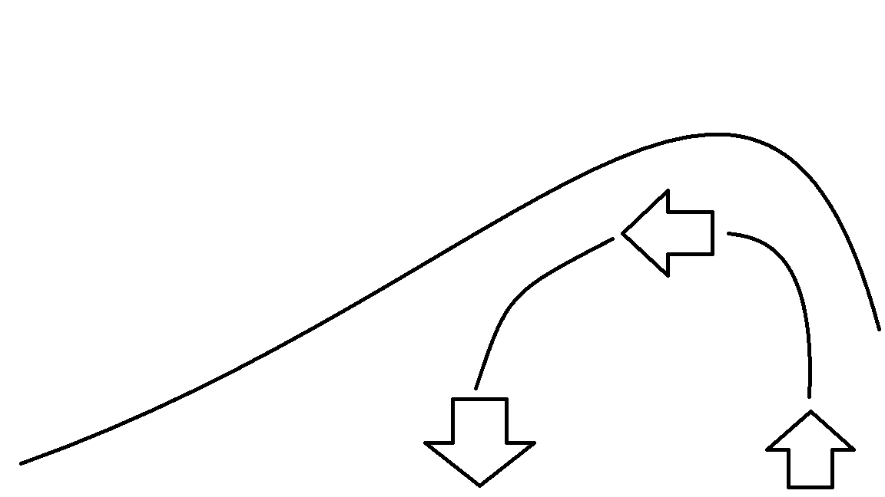

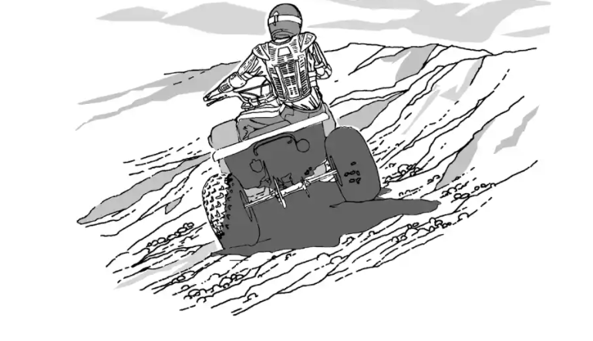
Traversing Hills
1. Objective
  To ride up, traverse, and ride down a hill using proper techniques to safely ride on hilly terrain
  Wheels uphill (ATV)
  Wheels downhill (ROV)
  Assume proper riding/driving posture
2. Explain positioning, throttle, braking, and reversing.
3. Demonstrate Exercise
4. Conduct exercise

Slide 29
Night Vision Goggles
After completion of all lessons perform the open trail experience during daytime
Describe the effects of driving with NVGs
  Depth Perception
  Visual Acuity
  Limited Field of View
Drive the same open trail experience route with NVGs

Slide 30
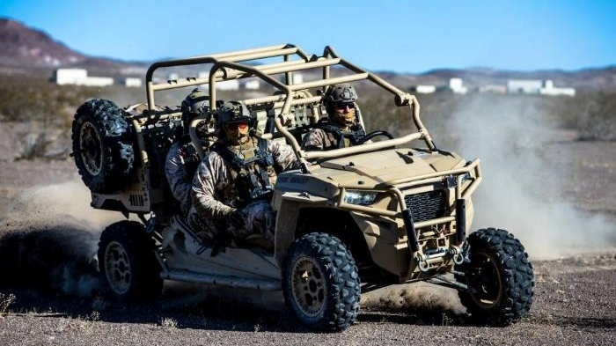
Open Trail Experience
Driving on ROCKY terrain
Driving on SANDY terrain
Driving near TREES
Driving through WATER
Driving through MUDDY terrain

Slide 31
Rocky Terrain
Rocky terrain requires careful, precision placement of the tires on the uneven surface.
  Be mindful of ground clearance and approach, departure, and ramp angles.
  Select Low gear.
  Increase ground clearance by putting larger obstacles under tires.
  Maintain throttle/brake control.
  Use a spotter when necessary.

Slide 32
Sandy Terrain
Sandy terrain demands constant input from the driver to the vehicle to properly maneuver.
  Always maintain momentum.
  Select Low gear.
  Avoid breaking traction or spinning wheels.
  Maintain floatation in dry sand by not following in tracks.
  Wet sand is typically denser, providing greater floatation to allow driving in tracks.
  Use gentle throttle.

Slide 33
Driving Near Trees
Knowing the size of the vehicle is imperative. Navigating through tight areas requires knowledge of the dimensions of the vehicle and its handling characteristics.

Slide 34
Driving Through Water
Never operate your vehicle in fast-flowing water or in water deeper than specified in the operator's manual.
  Avoid deep water.
  Select Low gear.
  Check water depth before attempting to cross.
  Use steady throttle.
  Avoid spinning wheels.
  Avoid splashing.
  Create a bow-wave with the front of the vehicle. Maintain steady forward momentum to keep the bow-wave in front of the vehicle.

Slide 35
Muddy Terrain
Mud may slow the vehicle abruptly and could cause loss of control if you enter too swiftly. Traction is key to passing through muddy sections.
  Use steady, gentle throttle to avoid breaking traction.
  Select Low gear.
  Maintain momentum.
  Avoid excessive braking.
  On deep muddy tracks, keep wheels inside ruts.
  Keep wheels straight.
  Avoid spinning wheels.

Slide 36
NOTES

